Slide 1

Flood Guard
TEAM NAME: TEAM MEMBERS: NISHIKA CHAUDHARY KASHISH KAUSHIK GUNGUN
DEEP DATA HACK2.0
“Smart Flood Monitoring &
Alert System”

Slide 2
INTRODUCTION
Floods are one of the most common and destructive natural disasters worldwide.
Every year, millions of people are affected due to sudden rise of water levels in rivers, drains, or heavy rainfall.
The major challenges during floods are:
Lack of early warning systems
Delay in rescue operations
High property & infrastructure damage
Flood Guard aims to solve this problem by:
Monitoring water levels in real-time
Sending instant alerts to authorities and local people
Helping communities take quick safety measures

Slide 3


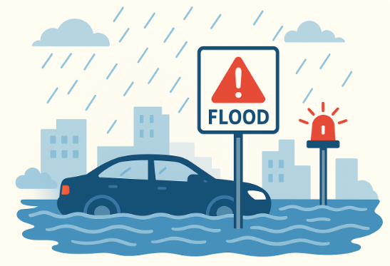
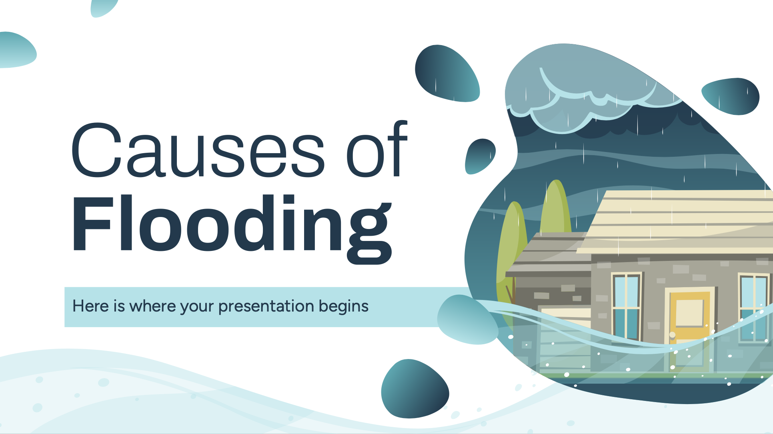

USES OF FLOOD GUARD
Real-time monitoring of water levels.
Instant alerts via mobile app/SMS to authorities & public.
Can be installed in urban drains, rivers, reservoirs, and dams.
Low-cost, scalable solution for disaster-prone regions.
Supports quick evacuation & resource management.

Slide 4



Languages Used & Application
Languages/Tech Stack:
TypeScript / JavaScript → Logic & functionality
TSX (React) → UI components
CSS (Tailwind) → Styling
HTML → Structure
Applications:
Flood-prone cities for early warnings
Rural areas with poor communication systems
Disaster management agencies
Government weather monitoring systems

Slide 5

FUTURE SCOPE OF FLOOD GUARD
AI + IoT integration for predictive flood analysis.
Satellite + weather data integration for more accuracy.
Expand system to predict landslides & cyclones.
Connect with smart city infrastructure (traffic lights, evacuation routes).
Use solar-powered sensors for remote rural areas.

Slide 6

CONCLUSION
Flood Guard offers a reliable, real-time flood monitoring system.
Scalable & future-ready with AI/IoT integration
Our mission:
“Safer Communities, Smarter Technology.”
Helps save lives & reduce property damage.

Slide 7
THANK YOU ANY QUESTIONS?

